Slide 1

Hotel Reservation Analysis Using SQL and Python
Insights into Guest Preferences and Booking Trends
Author: Abdul Mannan
Batch: MIP-DA-10

Slide 2
Project Overview
Objective: Analyze hotel reservation data to gain insights.
Tools Used: SQL, Python, Pandas.
Dataset: Contains information on bookings, guest details, and reservation specifics.

Slide 3
Dataset Overview
Columns:
- Booking_ID
- no_of_adults
- no_of_children
- no_of_weekend_nights
- no_of_week_nights
- type_of_meal_plan
- room_type_reserved
- lead_time
- arrival_date
- market_segment_type
- avg_price_per_room
- booking_status

Slide 4
Total Reservations
Total number of reservations in the dataset: 36275

Slide 5
Most Popular Meal Plan
Most popular meal plan among guests: Meal Plan 1

Slide 6
Average Price for Reservations with Children
Average price per room for reservations involving children: 103.26

Slide 7
Most Commonly Booked Room Type
Most commonly booked room type: Room_Type 1

Slide 8
Lead Time for Reservations
Highest lead time: 158
Lowest lead time: 1

Slide 9
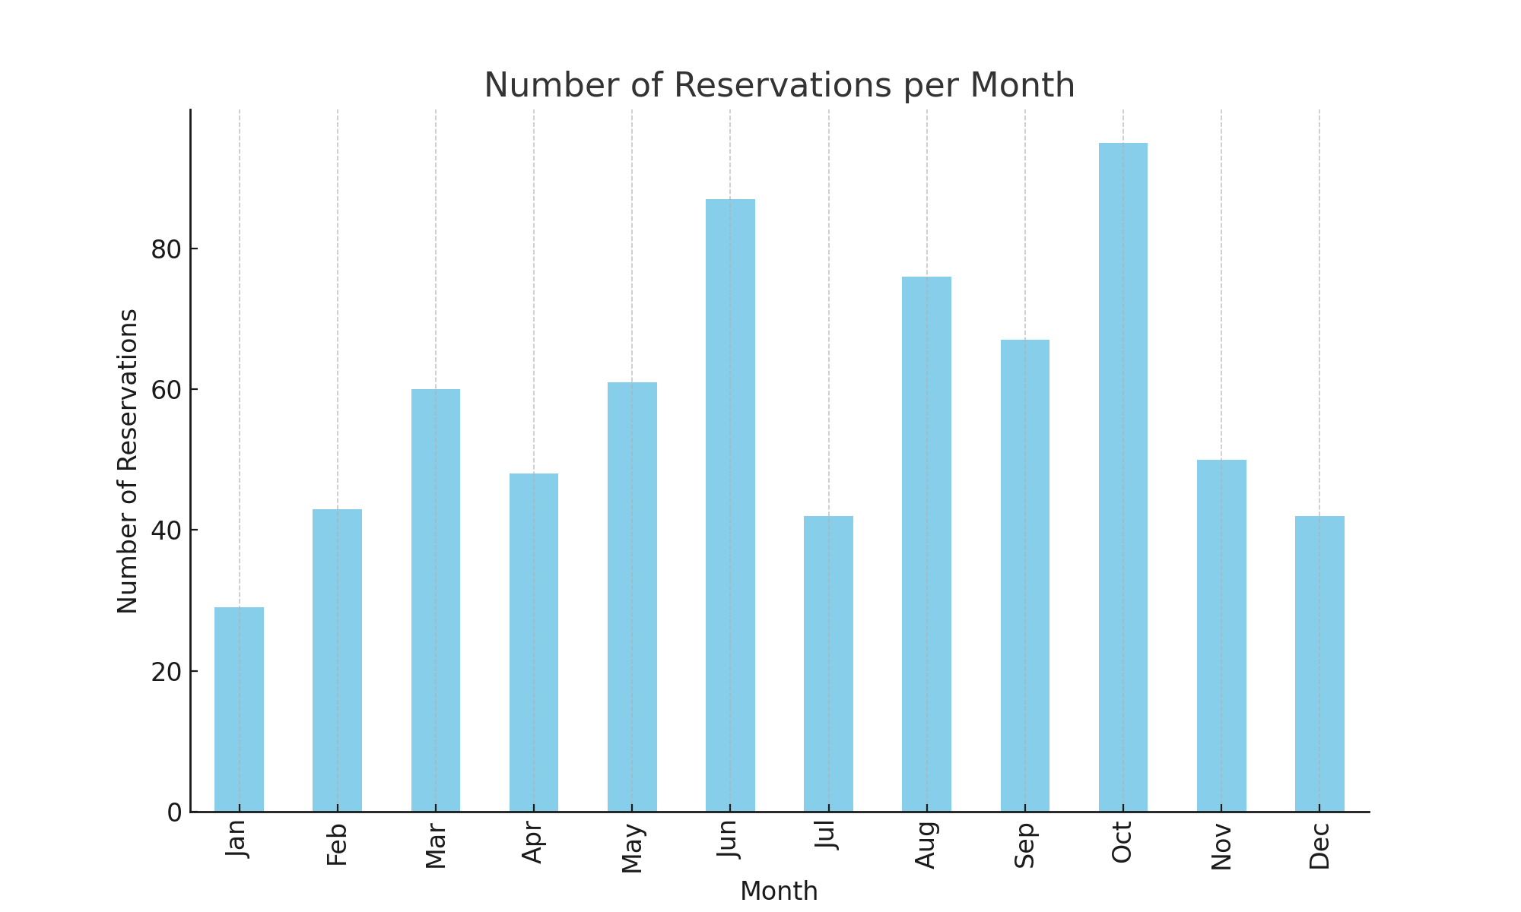
Monthly Reservations
Number of reservations made in each month:

Slide 10
Conclusion
Summary of key insights:
- Most popular meal plan: Meal Plan 1
- Commonly booked room type: Room_Type 1
- Highest lead time: 158 days
- Monthly reservations analysis
Future steps for further analysis or implementation.

